Slide 6
WHAT WOULD YOU DO?
You find $5 dollars – WWYD: Buy one treat for yourself or enough treats to share.
You and your sibling can’t decide on a game you want to play – WWYD: Do what you want or what your sibling wants?
You can tell Mom and Dad are having a tough day – WWYD: Do you avoid them or ask them how you can help?
At lunch, you’re about to have your favorite dessert and you notice a sad friend – WWYD: Ignore the friend and eat your dessert or do you find out what’s wrong and offer to share the dessert? Next Level WWYD: Do you give part of the dessert, half of the dessert or all of the dessert?

Slide 8
Customizable Slide
Click here to change the text or delete this slide if not needed.
(Can be used for promoting other school events, PTA membership, etc. )

Slide 10
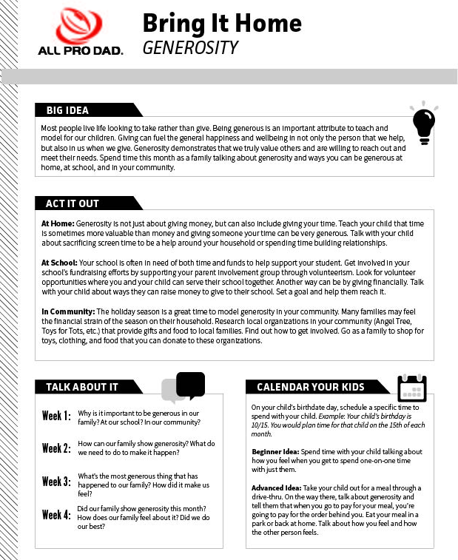
Bring It Home
An at-home resource for you to continue the conversation!
Log into you All Pro Dad’s Day Member account to download and print.

Slide 11
INSERT NEXT MEETING DETAILS

